Slide 1
React JS
(CRA Conventions)
Lecture-16

Slide 2
Today’s Agenda
Exercise To Better Understand Request Flow
CRA Conventions
How To Load Images In CRA ?
How To Add CSS Files In CRA ?

Slide 3
Exercise
Create an app with the following files:
food.js: This file should contain an array of fruit emojis called foods
helper.js: This file should contain two functions called choice() and remove() .
choice(): This function should accept the foods array and should return a random food
remove(): This function should accept the foods array and a food and should remove that food from foods array and return a new array of remaining foods

Slide 4
Exercise
Fruits.js: This file should have a class component called Fruits which should do the following:
Display total number of foods
Display these foods
Pick a random food
Remove that food from foods
Display remaining foods
App.js: This file should render the Fruits component
index.js: To render the App component

Slide 5
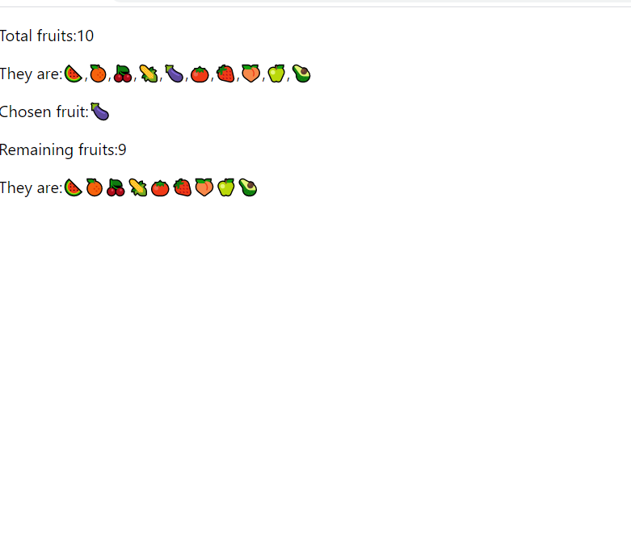
Desired Output

Slide 6
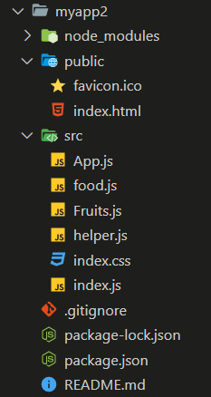
Structure Of The App

Slide 7
The foods.js File
foods.js
const foods = ["🍉", "🍊", "🍒", "🌽", "🍆", "🍅",
"🍓", "🍑", "🍏", "🥑"];
export default foods;

Slide 8
The helper.js File
helper.js
function choice(items) {
let idx = Math.floor(Math.random() * items.length);
return items[idx];
}
function remove(items, item) {
let i = items.indexOf(item);
return [...items.slice(0, i), ...items.slice(i + 1)];
}
export { choice, remove };

Slide 9
The Fruits.js File
Fruits.js
import foods from "./food";
import { choice, remove } from "./helper";
import { Component } from "react";
class Fruits extends Component {
render() {
let fruit = choice(foods);
let remaining = remove(foods, fruit);
return (
<div>
<p>Total fruits:{foods.length}</p>
<p>They are:{foods.join()}</p>
<p>Chosen fruit:{fruit}</p>
<p>Remaining fruits:{remaining.length}</p>
<p>They are:{remaining.join()}</p>
</div>
);
}
}
export default Fruits;

Slide 10
The App.js File
App.js
import Fruits from "./Fruits";
import { Component } from "react";
class App extends Component {
render() {
return (
<div>
<Fruits />
</div>
);
}
}
export default App;

Slide 11
The index.js File
index.js
import ReactDOM from "react-dom";
import App from "./App";
import "./index.css";
let root = ReactDOM.createRoot(document.querySelector("#root"));
root.render(<App />);

Slide 12
CRA Conventions
To become a good React developer there are design guidelines and code conventions which we must follow
If our application follows standard conventions then it becomes easier for other team members to understand the flow of our application

Slide 13
CRA Conventions
Each React Component should live in a separate file
Keep the file name same as the name of component class or component function
Start the component name as well as file name with uppercase letter
Example:
src/Employee.js for Employee Component.
src/Car.js for Car Component.
src/House.js for House Component.

Slide 14
CRA Conventions
Import React, {Component} from react and make your component class extend Component
Example
import React, { Component } from "react";
class Hello extends Component {
…..
}

Slide 15
CRA Conventions
Always export your component as default component
Example
import React, { Component } from "react";
class Hello extends Component {
…..
}
export default Hello;

Slide 16
CRA Conventions
CRA skeleton always assumes that App is your top level component and most of the developers also follow this.
So its better to stick to this convention
Example
import React, { Component } from "react";
class App extends Component {
…..
}
export default App;

Slide 17
Assets And CRA
To include images and CSS we can import them in js files
For example this is our default app.js file :
import logo from './logo.svg';
import './App.css';
function App() {
return (
<div className="App">
<header className="App-header">
<img src={logo} className="App-logo" alt="logo" />
<p>
Edit <code>src/App.js</code> and save to reload.
</p>
Learn React
</a>
</header>
</div>
);
} export default App;

Slide 18
Images And CRA
We can import an image file right in a JavaScript module.
This tells webpack to include that file in the bundle.
When we do this we get a string value.

Slide 19
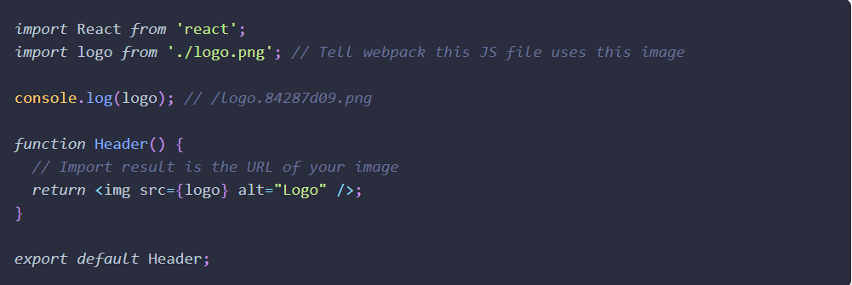
Example

Slide 20
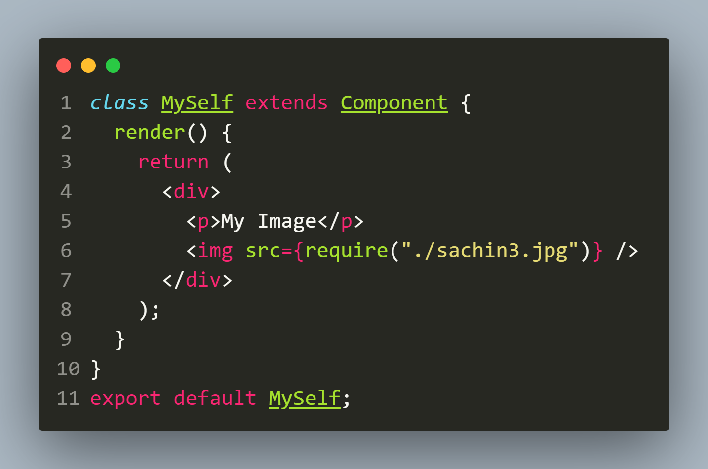
Another Way Of Loading Images
We can also use the require function to load the images into our component.

Slide 21
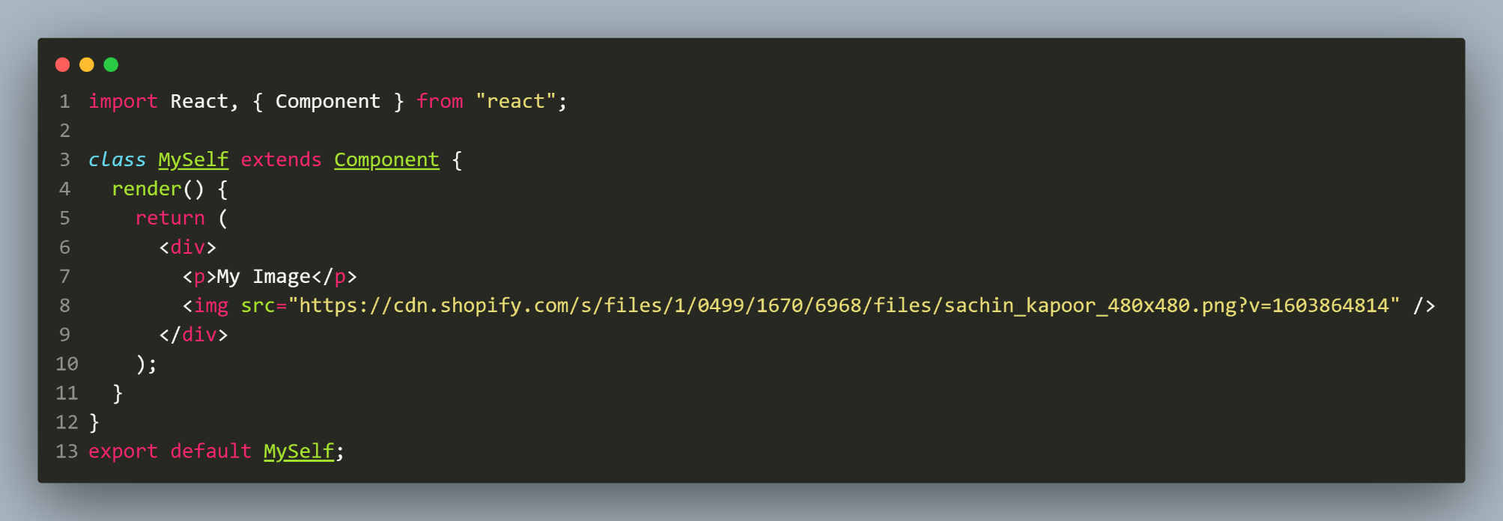
Loading Network Images
If we are loading images from the network, then it's a pretty straightforward approach.

Slide 22
CSS And CRA
Make a CSS file for each React component:
House.css for House component.
Import It at the top of the Component . For ex House.js
Create-React-App will automatically load that css.
Conventional to add className = “House” onto House div
And use that as prefix for sub-items to style:
<div className = "House">
<p className = "House-Title">{this.props.title}</p>
<p className = "House-Address">{this.props.addr}</p>
</div>

Slide 23
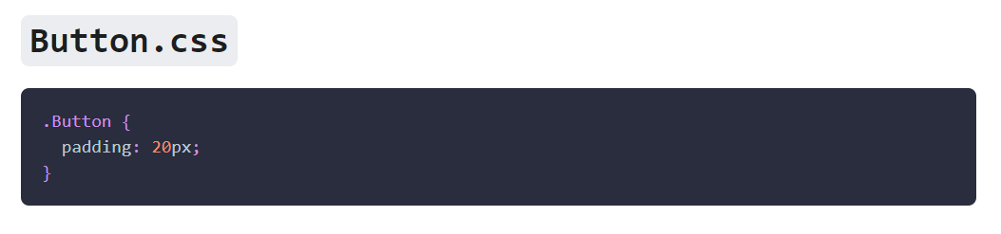
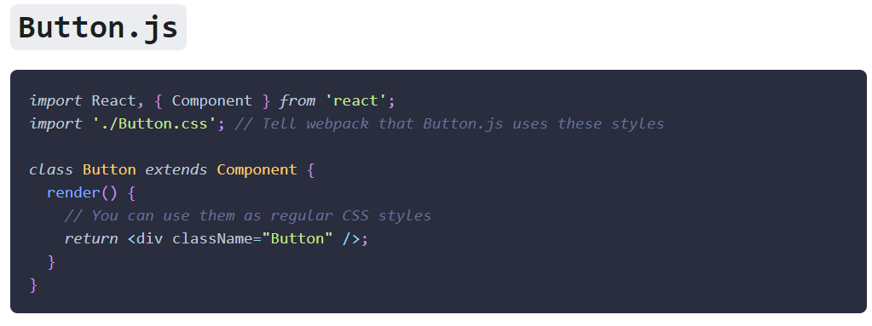
Example

